Slide 1
Cluster Analysis

Slide 2

Cluster Analysis
Divide data into similar groups
Goals of cluster analysis:
Clustering for understanding data (Info. retrieval, climate, business)
Clustering as a utility (summarization, compression, nearest neighbour search)

Slide 3
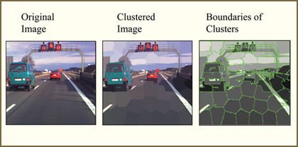
Cluster Analysis
Divide data into similar groups
Goals of cluster analysis:
Clustering for understanding data (Info. retrieval, climate, business)
Clustering as a utility (summarization, compression, nearest neighbour search)

Slide 4
Agglomerative Hierarchical Clustering
Starts with each point being a cluster, and at each step, merge the closest pair of clusters
Displayed graphically using a dendrogram – a tree like structure (dendro "tree", gramma "drawing")

Slide 5
Agglomerative Hierarchical Clustering
Starts with each point being a cluster, and at each step, merge the closest pair of clusters
Can also be displayed graphically using a nested cluster diagram - for 2D points

Slide 6
Agglomerative Hierarchical Clustering
Basic algorithm
Compute the proximity matrix
Let each data point be a cluster
Repeat
Merge the two closest clusters
Update the proximity matrix
Until only a single cluster remains
Key operation is the computation of the proximity of two clusters
Different approaches to defining the distance between clusters distinguish the different algorithms

Slide 7
Starting Situation
Start with clusters of individual points and a proximity matrix
p1
p2
p3
p4
p5
. . .
p1
p2
p3
p4
p5
.
.
.
Proximity Matrix

Slide 8
Intermediate Situation
After some merging steps, we have some clusters
C1
C2
C3
C4
C5
C1
C2
C3
C3
C4
C4
C5
Proximity Matrix
C1
C2
C5

Slide 9
Intermediate Situation
We want to merge the two closest clusters (C2 and C5) and update the proximity matrix.
C1
C2
C3
C4
C5
C1
C2
C3
C3
C4
C4
C5
Proximity Matrix
C1
C2
C5

Slide 10
After Merging
The question is “How do we update the proximity matrix?”
For ex: we can compute proximity from cluster centroids.
C2 U C5
C1
C3
C4
C1
?
C2 U C5
? ? ? ?
C3
C3
?
C4
C4
?
Proximity Matrix
C1
C2 U C5

Slide 11
How to Define Inter-Cluster Similarity
p1
p2
p3
p4
p5
. . .
p1
Similarity?
p2
p3
p4
p5
MIN
MAX
Group Average
Distance Between Centroids
.
.
.
Proximity Matrix

Slide 12
How to Define Inter-Cluster Similarity
p1
p2
p3
p4
p5
. . .
p1
p2
p3
p4
p5
MIN
MAX
Group Average
Distance Between Centroids
.
.
.
Proximity Matrix

Slide 13
How to Define Inter-Cluster Similarity
p1
p2
p3
p4
p5
. . .
p1
p2
p3
p4
p5
MIN
MAX
Group Average
Distance Between Centroids
.
.
.
Proximity Matrix

Slide 14
How to Define Inter-Cluster Similarity
p1
p2
p3
p4
p5
. . .
p1
p2
p3
p4
p5
MIN
MAX
Group Average
Distance Between Centroids
.
.
.
Proximity Matrix

Slide 15
How to Define Inter-Cluster Similarity
p1
p2
p3
p4
p5
. . .
p1
×
×
p2
p3
p4
p5
MIN
MAX
Group Average
Distance Between Centroids
.
.
.
Proximity Matrix

Slide 16
Cluster Similarity: MIN or Single Link
Similarity of two clusters is based on the two most similar (closest) points in the different clusters
1
2
3
4
5

Slide 17
Cluster Similarity: MAX or Complete Linkage
Similarity of two clusters is based on the two least similar (most distant) points in the different clusters
1
2
3
4
5

Slide 18
Hierarchical Clustering: Comparison
5
1
4
1
3
2
5
5
5
2
1
MIN
2
MAX
2
3
6
3
3
6
1
4
4
4
5
1
2
5
2
3
6
Group Average
3
1
4
4

Slide 19
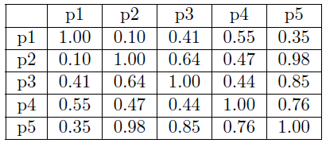
Examples
Given the data above, perform single link and complete link hierarchical clustering. Draw dendrogram of your results.

Slide 20
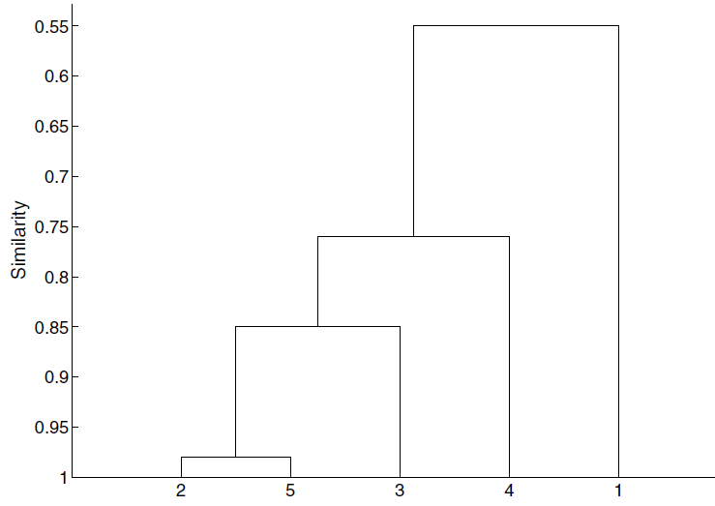
Examples
Given the data above, perform single link and complete link hierarchical clustering. Draw dendrogram of your results.
Single Link:

Slide 21
First, maximum proximity is between p2 and p5 of 0.98
p2 and p5 are grouped together to form a cluster.
Second, next maximum proximity is between p3 and p5 of 0.85
Here we merge p3 with the cluster {p2, p5}.
Third, next maximum proximity is between p4 and p5 of 0.76.
Here we merge p4 with the cluster {p2, p3, p5}.
Fourth, next maximum proximity of 0.64 is between p2 and p3 but they are already in the cluster.
Fifth, next maximum proximity of 0.55 is between p1 and p4 so we have added all the points to form the cluster {p1, p2, p3, p4, p5}.

Slide 22
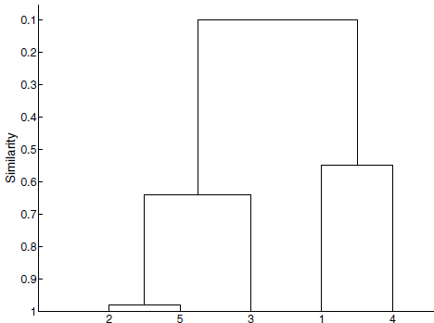
Examples
Given the data above, perform single link and complete link hierarchical clustering. Draw dendrogram of your results.
Single Link: Complete Link

Slide 23
Step 1: p2 and p5 are merged for being in proximity.
After p2 and p5 are merged to form a cluster.
New Proximity Matrix After Complete Link:
 | P1 | P2, P5 | P3 | P4
P1 | 1 | 0.10 | 0.41 | 0.55
P2, P5 | 0.10 | 1 | 0.64 | 0.47
P3 | 0.41 | 0.64 | 1 | 0.44
P4 | 0.55 | 0.47 | 0.44 | 1
Step 2: p3 is merged with {p2, p5}

Slide 24
Thank You!

